Slide 1
DSpace Customization
Mukesh Pund
Scientist
NISCAIR
New Delhi

Slide 2
Why to Customize
Your own institutional need
User interface enhancements
Mark-up quality and accessibility

Slide 3
Ways to Customize
User Interface
Metadata
Browse and Search
Language

Slide 4
Skill Required for DSpace Customization
Understanding of XHTML
Understanding of CSS

Slide 5
Three Layers of DSpace
Application Layer (UI) : JSPs (XHTML/CSS) & Servlets
Business Logic Layer : Java Classes / Objects
Storage Layer : Database & Filesystem APIs

Slide 6
JSPs (Java Server Pages) create HTML for the browsers to display
JSP Tags, which help to "build" the webpage, and usually contain code useful to many different JSPs.
Java Servlets, which perform any requests a User makes through the UI, and provide JSPs with all the information they need to create the next webpage.
Java Classes, which define and retrieve information about the "objects" within the system.

Slide 7
DSpace Directories
Source Directories ([/dspace/dspace-1.4.2-source/])
All customization generally takes place here
  config/ - DSpace configurations
  jsp/ - DSpace JSPs
  src/ - DSpace Servlets & Classes
Installed Directories ([/dspace/])
  Home to all "live" configuration files, properties, Java libraries (including dspace.jar)
  Usually home to log files, reports, search indices, and "bitstreams" themselves!
Webapplication Directory ([/dspace/apache-tomcat-5.5.25/webapps/])
  Home to all compiled servlets and JSPs
  Basic customizations can also takes place here (if you decide to do after installation)

Slide 8
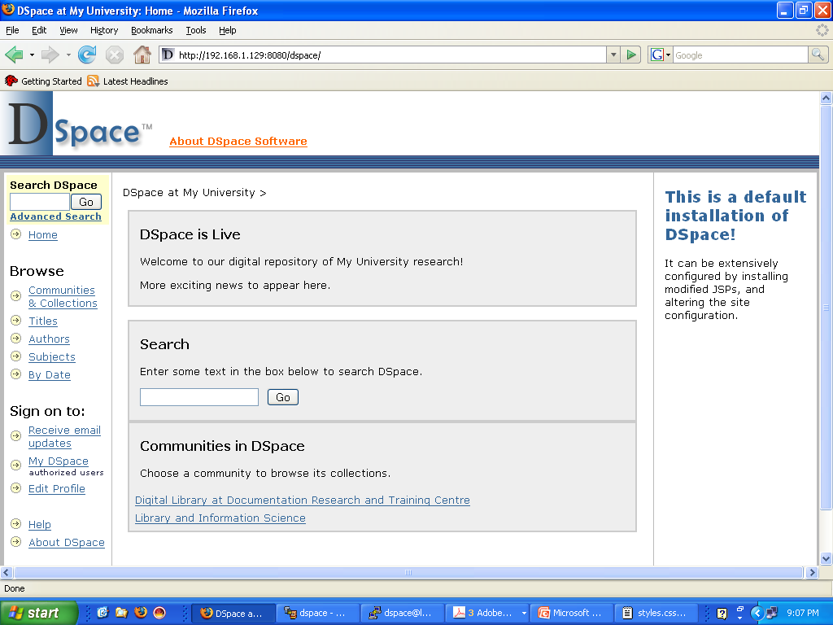
Header
Location Bar
Side Bar News
Top News
Footer

Slide 9
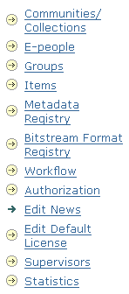

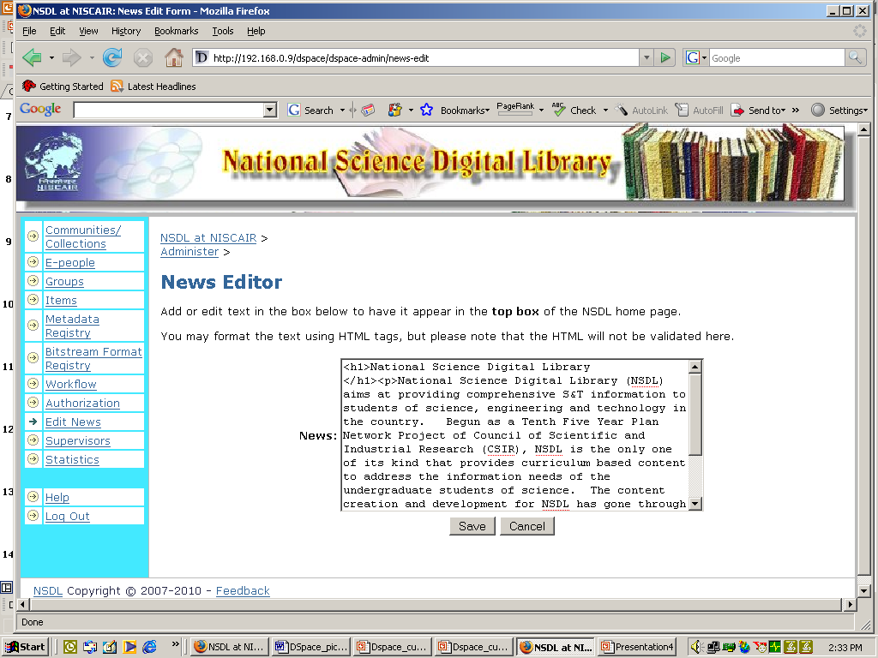
Basic Customization: Top News
Step 1
Step 2
Step 3
To change the Sidebar News, follow the same steps as shown in the above for Top News, only instead of Top News, choose Sidebar News (of Step 2)

Slide 10
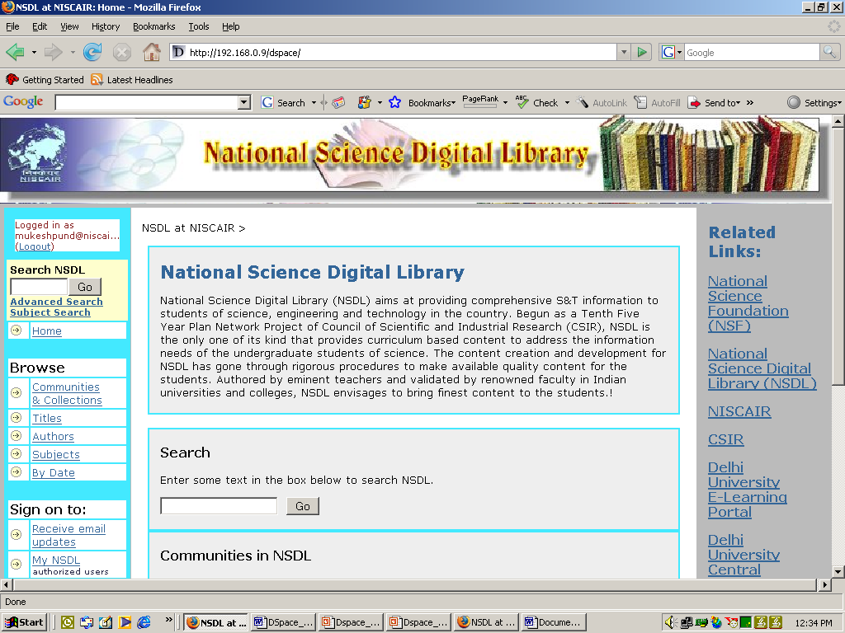
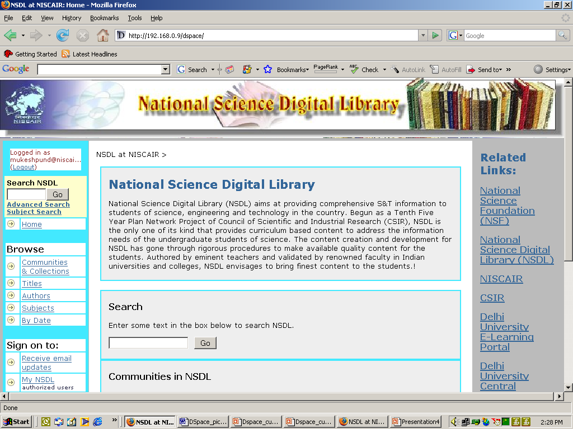
Basic Customization: Top News & Sidebar News
Top News
Sidebar News
This is done from DSpace Administrator screen as shown in the next slide

Slide 11
Customization: Header/ Footer/ Navbar
Files Located in:
Before Compilation:
  /dspace/dspace-source/jsp/layout/*.jsp
After Compilation:
  /dspace/apache-tomcat-5.5.25/webapps/dspace/layout/*.jsp
Change the HTML in header-default.jsp, footer-default.jsp, location-bar.jsp, navbar.jsp, ….
N.B. If you don’t want something to be appeared in the site, just comment it using <%-- and --%>
Example:
<%-- <form method="get" action="<%= request.getContextPath() %>/simple-search"> --%>
Remember: After making the necessary changes, just refresh the page to get effects

Slide 12
Customization: Location Bar
Files Located in:
Before Compilation:
  /dspace/dspace-source/config/dspace.cfg
After Compilation:
  /dspace/config/dspace.cfg
Change name of the site in
dspace.name = “DSpace Short-Term Course”

Slide 13
Customization: CSS
CSS file Located in:
Before Compilation:
  /dspace/dspace-source/jsp/styles.css.jsp
After Compilation:
  /dspace/apache-tomcat-5.5.25/webapps/dspace/styles.css.jsp
  BODY { font-family: "verdana", Arial, Helvetica, sans-serif;
  font-size: 10pt;
  font-style: normal;
  color: #000000;
  background: #bbbbbb;
  margin: 0;
  padding: 0;
  margin-left:0px;
  margin-right:0px;
  margin-top:0px;
  margin-bottom:0px }
Remember: After making the necessary changes, just refresh the page to get effects

Slide 14
Customization: XHTML
In JSP pages, Java code is surrounded by <%java code%> or <%=java variable%>. Any other thing outside of that is XHTML (except for JSP Tags).
<td>
<a href="<%= request.getContextPath() %>/"><a href="http://drtc.isibang.ac.in"><img src="<%= request.getContextPath() %>/image/isilogo.jpg" alt="<fmt:message key="jsp.layout.header-default.alt"/>" width="102" height="100" border="0"/></a></a>
</td>
<td class="tagLine" width="99%"> <%-- Make as wide as possible. cellpadding repeated for broken NS 4.x --%>
<h1 align="center">DSpace Training at NISCAIR</h1>
</td>
Remember: After making the necessary changes, just refresh the page to get effects

Slide 15


Slide 16
Customization: Text
“Messages.properties” contains almost all the text of DSpace
Located in:
  Before Comlilation:
  /dspace/dspace-1.4.2-source/config/language-packs/
  After Compilation:
  /dspace/apache-tomcat-5.5.25/webapps/dspace/WEB-INF/classes/
  Format of “Messages.properties”
  jsp.layout.navbar-default.authors = Authors
  (Navigation bar text “Authors” shared by pages in /jsp/layout/navbar-default.jsp)
Remember: If changes are made in the “Messages.properties” after compilation, then we need to “shut-down” and “re-start” the Tomcat

Slide 17
Customization: Text
Keys in Messages.properties referenced in JSP with:
<fmt:message key=“jsp.layout.navbar-default.authors”/>
(/jsp/layout/navbar-default.jsp)
The text corresponds to a property "key" named after the JSP or Tag in which it appears.
Example:
  jsp.community-home.heading1 is a heading within /jsp/community-home.jsp
  jsp.general.search.button is the text that appears on ALL search buttons in DSpace

Slide 18
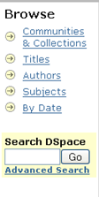
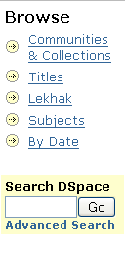
Customization: Text
Before
After

Slide 19
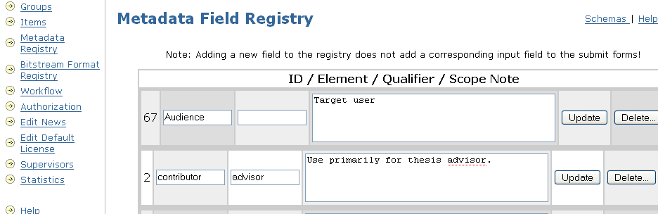
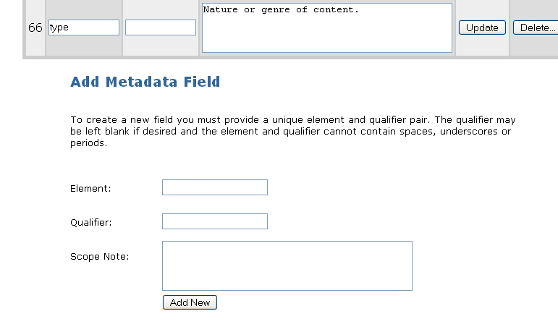
Customization: Add Metadata

Slide 20
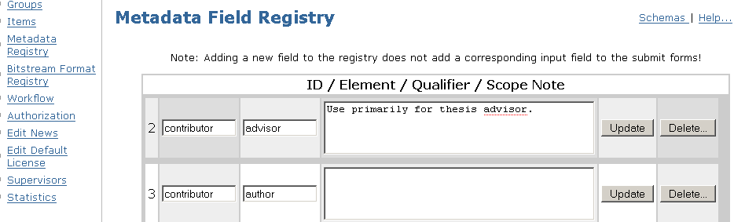
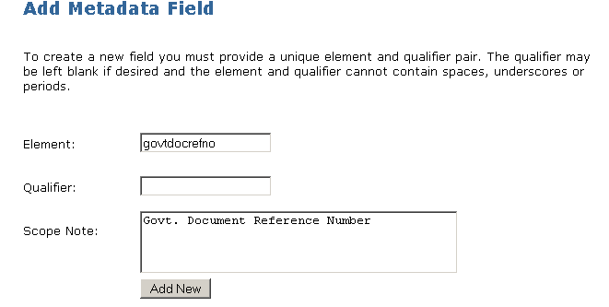
Customization: Metadata
Add/ Update Metadata from DSpace Administrator interface (http://192.168.1.129:8080/dspace/dspace-admin)

Slide 21
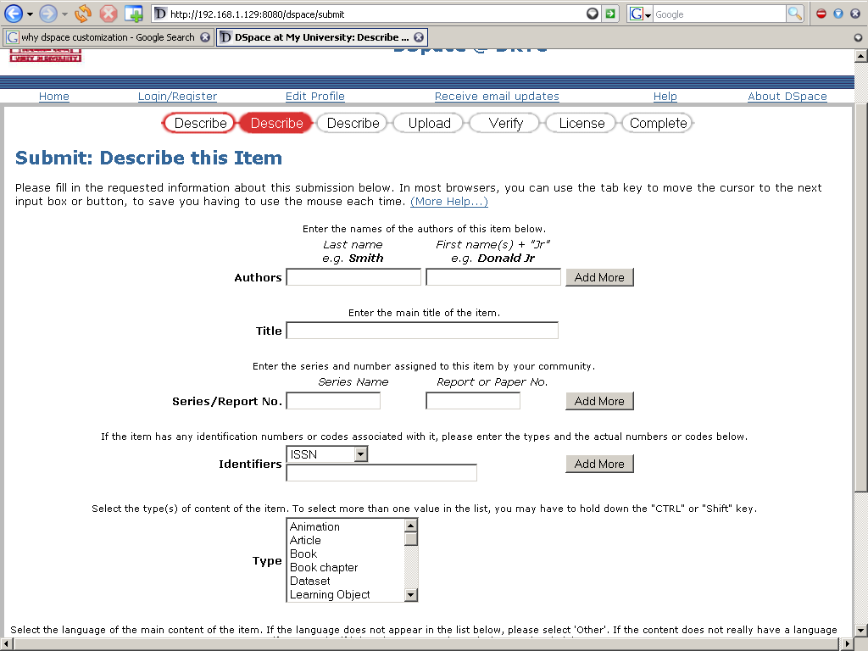
Customization: Submit/ Input Form

Slide 22
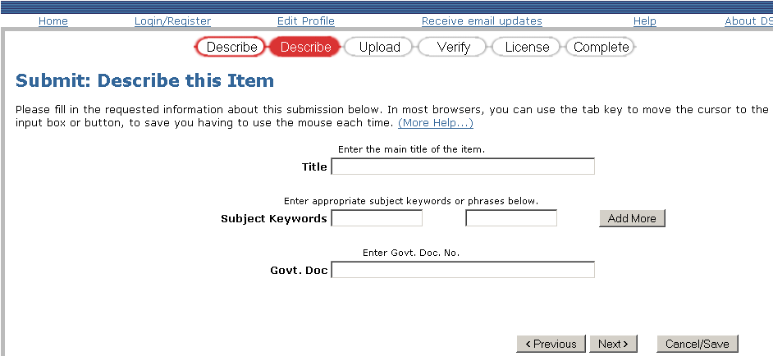
Customization: Submit/ Input Form
Submission form is located in:
Before Compilation: /dspace/dspace-1.4.2-source/config/input-forms.xml
After Compilation: /dspace/config/input-forms.xml

Slide 23
Customization: Submit/ Input Form
General format of input-forms.xml
<page number="1">
<field>
<dc-element>govtdocrefno</dc-element>
<dc-qualifier></dc-qualifier>
<repeatable></repeatable>
<label>Govt. Doc</label>
<input-type>onebox</input-type>
<hint>Enter Govt. Doc. No.</hint>
<required></required>
</field>
</page>
……………….
Remember: After making any changes in the input form, re-start the Tomcat server

Slide 24
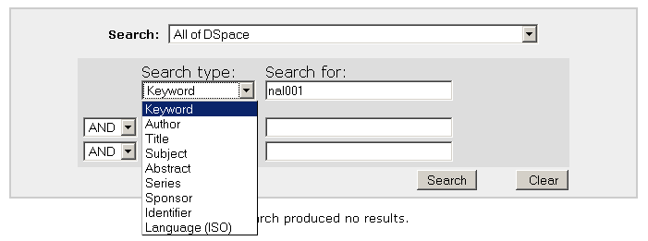
Customization: Search
Customize Advanced Search options: /dspace/config/dspace.cfg

Slide 25
Customization: Search
Edit the search index in: /dspace/config/dspace.cfg
This can change only your search result, not search display
………….
search.index.11 = identifier:dc.identifier.*
search.index.12 = language:dc.language.iso
search.index.13 = keyword:dc.govtdocrefno.*
…………..
The general format is:
search.index.[number] = [search field]:element.qualifier
Remember: After making changes, re-index everything (go to /dspace/bin and execute the command, ./index-all

Slide 26
Customization: Search
To change the search display, edit advanced.jsp, dspace.cfg and Messages.properties
advanced.jsp located in:
Before compilation:
/dspace/dspace-1.4.2-source/jsp/search/
After compilation:
/dspace/apache-tomcat-5.5.25/webapps/dspace/search/
Messages.properties located in:
Before compilation: /dspace/dspace-source/config/language-packs/
After compilation:
/dspace/apache-tomcat-5.5.25/webapps/dspace/WEB-INF/classes/

Slide 27
Customization: Search
In advanced.jsp
<option value="govtdocrefno" <%= field1.equals("govtdocrefno") ? "selected=\"selected\"" : "" %>><fmt:message key="jsp.search.advanced.type.govtdocrefno"/></option>
In dspace.cfg
search.index.13 = govtdocrefno:dc.govtdocrefno.*
In Messages.properties
jsp.search.advanced.type.govtdocrefno = Govt Doc. No.

Slide 28
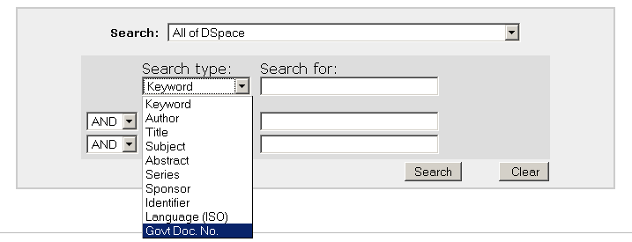
Customization: Search

Slide 29
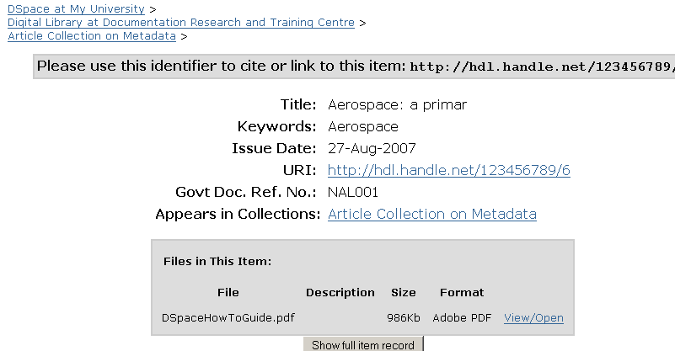
Customization: Item Display
To modify the metadata displayed in item screen, modify dspace.cfg and Messages.properties
Remember: After making changes, re-index everything (go to /dspace/bin and execute the command, ./index-all

Slide 30
Customization: Item Display
In dspace.cfg, add the new field to be displayed/ or change the order to display
webui.itemdisplay.default = dc.title, dc.title.alternative, dc.contributor.*, \
dc.subject, dc.date.issued(date), dc.publisher, \
dc.identifier.citation, dc.relation.ispartofseries, \
dc.description.abstract, dc.description, \
dc.identifier.govdoc, dc.identifier.uri(link), \
dc.identifier.isbn, dc.identifier.issn, \
dc.identifier.ismn, dc.identifier, \
dc.govtdocrefno.*
In Messages.properties, name the field to be displayed
metadata.dc.title = Title
metadata.dc.title.alternative = Other Titles
metadata.dc.contributor.* = Authors
metadata.dc.contributor.author = Authors
...
metadata.dc.identifier.isbn = ISBN
metadata.dc.govtdocrefno.* = Govt Doc. Ref. No.

Slide 31
Customization: Browse Fields
To modify the browse fields in navigation bar, modify dspace.cfg located in /dspace/config/dspace.cfg
.
In dspace.cfg, uncomment the following lines to specify the metadata fields are to be browsed in DSpace:- “Browse by Date”, “Browse Authors”, “Browse Titles” and “Browse Subjects”:-
# webui.browse.index.date = dc.date.issued
# webui.browse.index.author = dc.contributor.*
# webui.browse.index.title = dc.title
# webui.browse.index.subject = dc.subject.*
After modification in any of the browse indicies in dspace.cfg, one must Re-index for changes to take place.

Slide 32
Customization: Change Browse Layout
In dspace.cfg, one can change the metadata fields which are displayed for each item in browse item listing.
Make the required changes in the following single line in dspace.cfg and uncomment it:
#webui.itemlist.columns = dc.date.issued(date), dc.title, dc.contributor.*
Stop and restart Tomcat for changes to take affect.

Slide 33
Customization: Full text indexing
Configure media filters in dspace.cfg under
#### Media Filter plugins###
Enable or disable specific media filter from the list:-
plugin.sequence.org.dspace.app.mediafilter.Mediafilter = \
org.dspace.app.mediafilter.PDFFilter, \
org.dspace.app.mediafilter.HTMLFilter, \
org.dspace.app.mediafilter.WordFilter, \
org.dspace.app.mediafilter.JPEGFilter
2. Schedule filter-media by cron entry
0 2 * * * /dspace/bin/filter-media
3. Modify
search.maxfieldlength = 10000
Set it to -1 for indexing unlimited no. of words
4. Re-index for the changes to take effect

Slide 34
Customization: Summary
Restart (Restart the webserver after configuration changes)
Stop Tomcat
  [/dspace/apache-tomcat-5.5.25]/bin/shutdown.sh
Start Tomcat
  [/dspace/apache-tomcat-5.5.25]/bin/startup.sh
Re-index DSpace
Log on to the machine running dspace.
Change directory to /dspace/bin
Run the re-index command
    ./index-all
Stop and restart Tomcat.

Slide 35
Customization: Summary
Customize | Changes | Action
Top/Side Bar News | Edit News from DSpace Administrator | Refresh
Header /Footer/ Nav Bar | X/layout/*.jsp | Refresh
Overall layout | X/styles.css.jsp | Refresh
Page Text | X/WEB-INF/classes/Message.properties | Shut down & restart Tomcat
Add metadata | Add/update metadata from Metadata Registry from DSpace Administrator | Refresh
Input Form | /dspace/config/input-form.xml | Shut down & restart Tomcat

Slide 36
Customization: Summary (Contd.)
Customize | Changes | Action
Search (Advanced) | Search index: /dspace/config/dspace.cfg Search option: X/search/advanced.jsp Option display: X/WEB-INF/classes/Message. properties | Re-index
Item display | /dspace/config/dspace.cfg X/WEB-INF/classes/Message. properties | Re-index
Browse field | /dspace/config/dspace.cfg | Re-index
Browse Layout | /dspace/config/dspace.cfg | Shut down & restart Tomcat
X = /dspace/apache-tomcat-5.5.25/webapps/dspace

Slide 37
Thank you

Slide 38

Customization: XHTML

Slide 39
Changes in dspace.cfg
$vi /dspace/dspace-1.4.2-source/config/dspace.cfg
dspace.url = [like http://192.168.3.203/dspace]
dspace.hostname = [hotsname or IP address of server]
dspace.name =[ dspace name like name of your Institution eg. NISCAIR Digital Library]
db.password = [the password you entered in the last step of postgesql installation]
mail.server =[hostname or IP address of server ex. mail.niscair.res.in]
mail.from.address = [email address]
feedback.recipient =[email address]
mail.admin = [email address of admin]
alert.recipient =[email address (not essential but very useful!)]
Save the file

Slide 40
Cron jobs
To perform certain task periodically we may use cron jobs by typing following command:
# crontab -e
# Send out subscription e-mails at 01:00 every day
0 1 * * * /dspace/bin/sub-daily
# Run the media filter at 02:00 every day
0 2 * * * /dspace/bin/filter-media
# Generate full-text index at 2.15 an
15 2 * * * /dspace/bin/index-all
# Clean up the database nightly at 2.40am
40 2 * * * vacuumdb --analyze dspace > /dev/null 2>&1" > /var/spool/cron/dspace
* | * | * | * | *
Minute 0-59 | Hour 0-23 (0 = midnight) | Day 1-31 | Month 1-12 | Weekday 0-6 (0 = Sunday)‏

